Slide 1
Compiler Project Updates Nov 4th
Arunabho Basu
Florida Institute of Cybersecurity Research Electrical and Computer Engineering Department

Slide 2
Progress at a glance
RISC-V Compiler Toolchain
RISC-V Compiler Addon
Physical Fault Modeling
Hardening Rules
GCC Cross Compiler built
Cross compiler turns C code to RISC-V executable
Targets bare-metal RISC-V core on QEMU emulator
Security hardening implemented through GCC add-on
Researching cross compiler stages and RV64I ISA
Physical Modeling of LFI
Memory mapping of faults
Assembler configuration
Hardening rules

Slide 3
GCC RISC-V Cross Compiler Toolchain
riscv64-linux-gnu
Targets Linux OS on RISC-V
Lightweight embedded linux like petalinux preferred
riscv64-unknown-elf-gcc
Targets bare-metal RISC-V
Using qemu emulator to run riscv64 executables
Yet to try it on actual riscv hardware
Another notable riscv cross compiler project
xPack riscv-none-elf-gcc
https://github.com/xpack-dev-tools/riscv-none-elf-gcc-xpack/releases/tag/v14.2.0-2
Questions about hardware in use

Slide 4
RISC-V compilation
Pre-processing
Replaces macros and includes header files, resulting in a pure C source file with no preprocessor directives.
riscv64-unknown-elf-gcc -E fics.c -o fics.i
Compilation
Translates the preprocessed C code into assembly code for the RISC-V architecture
riscv64-unknown-elf-gcc -S fics.i -o fics.s
Assembly
Converts the assembly code into machine code, resulting in an object file
riscv64-unknown-elf-as fics.s -o fics.o
Linking
combines one or more object files (and any required libraries) into a final executable file
riscv64-unknown-elf-gcc fics.o -o fics

Slide 5
RV64I - Extensions
Unique feature of RISCV ISA – Base ISA can be expanded using extensions
Extensions can be customized for suitable use cases
There is a possibility of using extensions to implement hardening^{[1]}
Hardened RISCV ISA
In this case compiler would not compile to base RISCV ISA, it will compile to hardened RISCV ISA [1] XuanTie VirtualZone: RISC-V-based Security Extensions | Xuan Jian, Alibaba Cloud https://riscv.org/blog/2022/04/xuantie-virtualzone-risc-v-based-security-extensions-xuan-jian-alibaba/

Slide 6
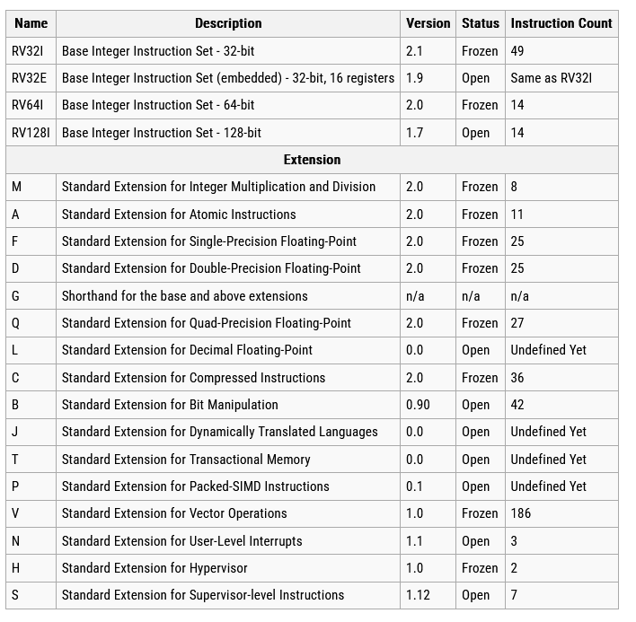
RISCV Extension Table

Slide 7
RISCV Extension Downside
Special Instruction Set – requires Special Hardware!
Custom RISCV core needed
Compatibility issues expected

Slide 8
Research Direction Question
Implement hardening :
In the Instruction Set itself?
OR
Compiler Addon?

Slide 9
Physical Fault Modelling
Existing GCC Options
Compile time Options
Run time Options
Control Flow Options
Stack Hardening
Function hardening
Jump statement hardening
Loop Hardening
Pointer Hardening
FI/SCA model vectors
FI
Laser
Clock
Voltage
SCA
EM Wave
Power
Time
Attacks which can be detected/prevented by these options

Slide 10
THANK YOU

